Slide 1



DATA-DRIVEN CONCERT STRATEGY
Powered by Data Insights from the Top 50 Global Tracks
QUOTE: WITHOUT DATA, YOU’RE JUST ANOTHER PERSON WITH AN OPINION
- W. EDWARDS DEMING
EWAKISI
DEI
CARLOS
THEOPHILUS
NEXT

Slide 2






PROJECT
OVERVIEW
Dataset: Spotify Global Top 50 Songs
Source: Kaggle/Spotify (CSV)
Goal: Use listener trends to design concert strategies.
Hypothesis:
- High energy + danceability = popular
songs.
- Pop dominates in quantity, but niche
genres are strong in quality.
- Artists with multiple hits = good long-
term bookings.

Slide 3

DATA ACQUISITION AND EXAMINATION
1
Used Python (pandas) to clean the data
3
Challenges: encoding, formatting, SQL issues.
2
Tasks: Rename columns, normalize 0-1, and remove duplicates.
4
One main dataset with 50 songs and 13 variables.

Slide 4
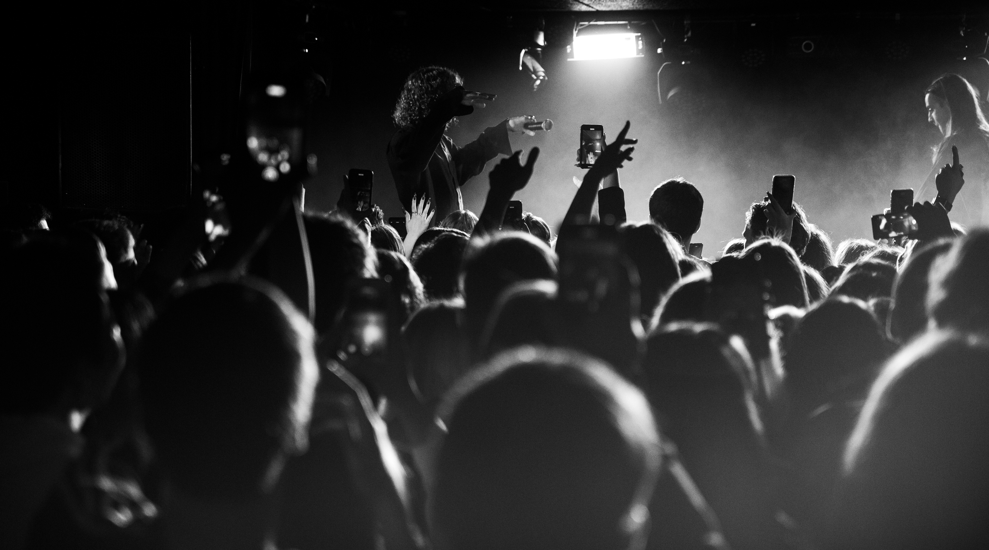
Database Design and Transformation
Database Tables: Artists, Genres, Tracks.
Created foreign keys for normalization
Data transformations included: genre/ artist IDs, scaling, dropping nulls
Loaded into MySQL using ‘CREATE’ + ‘INSERT’ scripts

Slide 5
SQL INSIGHTS & ANALYSIS
Queries used: JOIN, GROUP BY, HAVING, subqueries.
Revealed top genres (Dance Pop, Pop)
Identified high-energy party tracks with low acousticness.
Subqueries helped track average artist performance.

Slide 6




KEY DATA DRIVEN INSIGHT
ENERGY & DANCEABILITY > 0.6
RANSOM, CHINA, BAD GUY
REGGAETON, ELECTROPOP
BAD BUNNY, POST MALONE
Popular
Top Songs
Hot Genres:
Top Artists

Slide 7
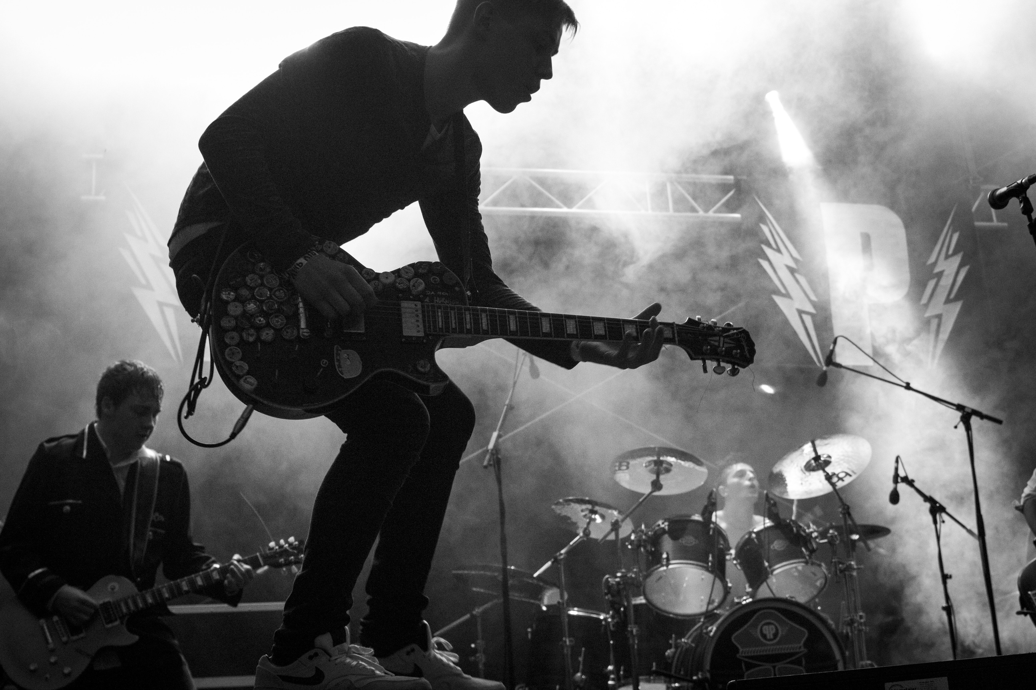






PROGRAMMING
STRATEGY
We use data-driven insights to craft optimized setlists by scheduling high-energy tracks during peak hours, blending popular genres like Pop with top-performing niche styles, and prioritizing artists who consistently generate strong audience engagement.

Slide 8


Studio Shodwe
CONCLUSIONS & BUSINESS IMPLICATIONS
Our analysis confirms that tracks with high energy and danceability tend to be more popular. While Pop remains a strong core genre, niche genres help build fan loyalty. These insights empower targeted artist bookings, smarter setlist planning, and enhanced crowd engagement—ultimately boosting both audience satisfaction and business profitability.
Page | 03

Slide 9

Studio Shodwe
OUR MISSION
main issues
Root cause
·Trying to insert tracks before inserting artists/genres
SQL foreign key constraint errors
Lesson Learned
Improvement
Load reference data first (load order matters)
·Improved understanding of database design & integrity
Page | 06

Slide 10

THANK'S FOR LISTENING
'WITHOUT DATA, YOU'RE JUST ANOTHER PERSON WITH AN OPINION.'

